Slide 1

Text Editors
Linux Essentials
Session-5

Slide 2
Text Editors

Slide 3
Vim Editor

Slide 4
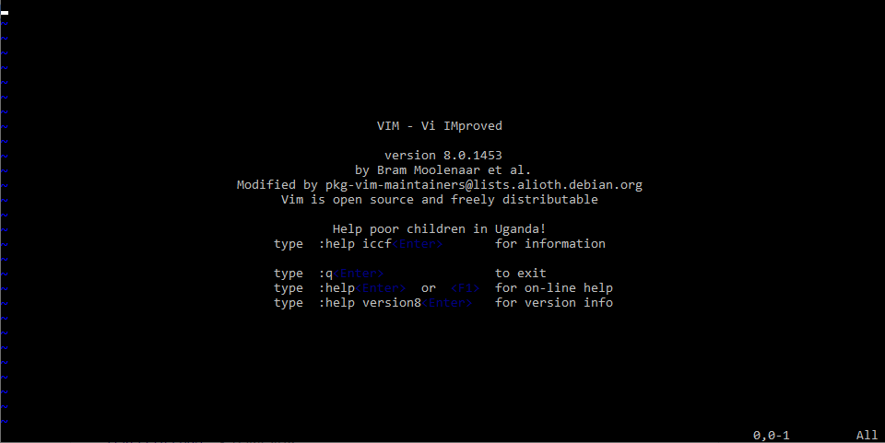
Vim Editor
vim filename
Vim is a powerful text editor used in CLI (command line interface).
Vim is an editor to create or edit a text file.
You cannot write text in command mode. To write text into a file, there is a dedicated insert mode. When you want to write something on a file, you must enter the insert mode.
Insert Mode
When you start Vim, you are placed in Command mode. In this mode, you can move across the screen, delete text and copy text.
Command Mode

Slide 5
Vim Editor
Vim Command | Decription
i | Enter insert mode
Esc | Enter command mode
x or Del | Delete a character
X | Delete character is backspace mode
u | Undo changes
Ctrl + r | Redo changes
yy | Copy a line
dd | Delete a line
p | Paste the content of the buffer
[[ or gg | Move to the beginning of a file
]] or G | Move to the end of a file
:%s/foo/bar/g | Search and replace all occurrences
Esc + :w | Save changes
Esc + :wq or Esc + ZZ | Save and quit Vim
Notes:
sample : https://www.youtube.com/watch?v=bVwgwaDmZp4

Slide 6
Nano Editor

Slide 7

Nano Editor
GNU nano is a small and friendly text editor.
Besides basic text editing, nano offers features like:
undo/redo
syntax coloring
interactive search-and-replace
auto-indentation
line numbers
word completion
file locking, backup files
internationalization support.

Slide 8
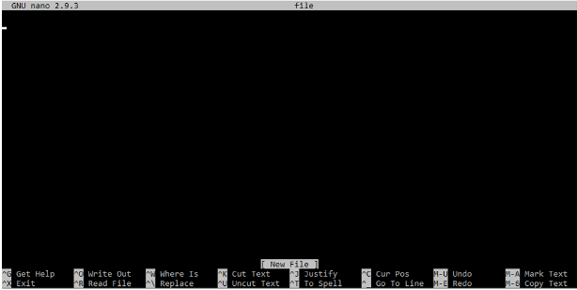
Nano Editor
Nano Command | Meaning
Ctrl G | Get Help
Ctrl X | Exit
Ctrl O | Write Out
Ctrl R | Read File
Ctrl W | Where Is
Ctrl \ Ctrl , | Replace
Ctrl K | Cut Text
Ctrl U | Uncut Text
Ctrl J | Justify
Ctrl T | To Spell
Ctrl C | Cur Pos
Alt U | Undo
Alt E | Redo
Unlike vim, nano is a modeless editor, which means that you can start typing and editing the text immediately after opening the file.
To open an existing file or to create a new file, type nano followed by the file name.
nano filename

Slide 9


Slide 10
THANKS!

